Slide 1
Introduction to Data Science
Exploratory Data Analysis Part 1

Slide 2
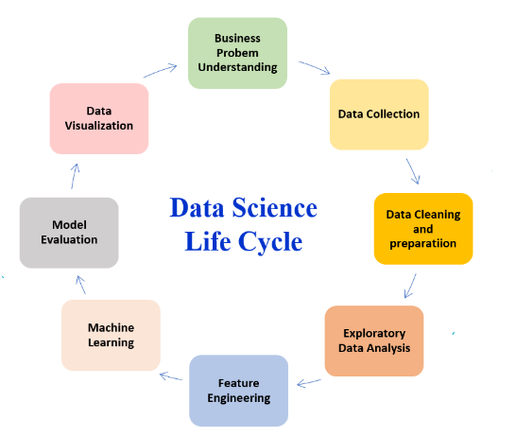
Recap

Slide 3
Exploratory Data Analysis (EDA)
Why?
-To discover patterns (correlations)
-To discover anomalies (outliers)
-Frame Hypothesis
-Check Assumptions
Univariate: Explore each individual variable in the dataset
- Summary statistics
- Spread
- Distribution
Bivariate: Assess interactions between variables (or between individual variables and the target)
- Correlation
-Analysis of variance (ANOVA)
Multivariate: Explore data across many dimensions
- Clustering
-Dimensionality reduction

Slide 4
Exploratory Data Analysis (EDA)
Tools (Week 7)
1. Introduction to simple statistics
1.1 Population vs sample data
1.2 Measure of centrality (mean, median, mode)
1.3 Measure of spread (std dev, variance)
2. Visualization Methods
2.1 Histograms
2.2 Scatter
2.3 Bar
2.4 Pie, time series, etc.
Analysis (Week 8)
1. Analyze one variable (univariate)
2. Analyze two variables (bivariate)
3. Analyze multiple variables (multivariate)
Output (Week 8)
What questions can the data answer?
What questions can the data NOT answer?
What questions can be asked from the data?

Slide 5
Statistics
What is the different between Population and Sample Data ?
Population
The entire group you want to study or understand.
It includes every individual in that group.
Example:
567 students = the whole population.
Sample
A subset of the population.
Used when measuring the entire population is not practical.
Must represent the population well.
Example:
144 students out of 567 = the sample.

Slide 6
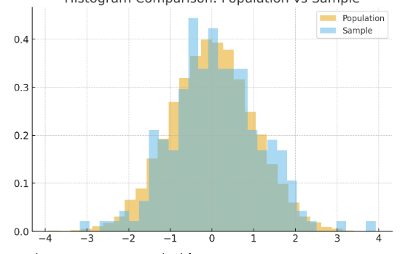
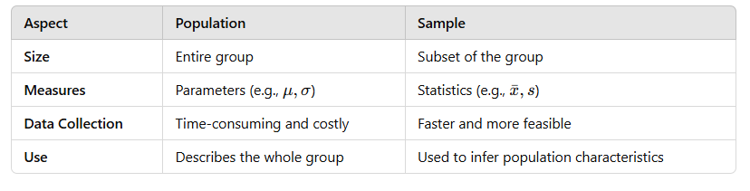
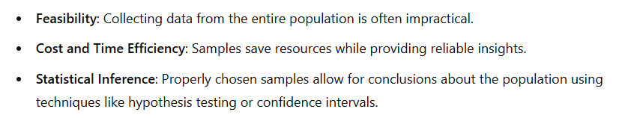
Population vs. Sample Data

Slide 7
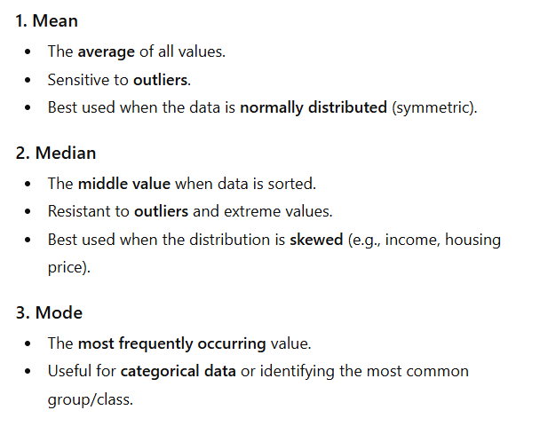
Measure of Centrality
What are the measures of centrality?

Slide 8
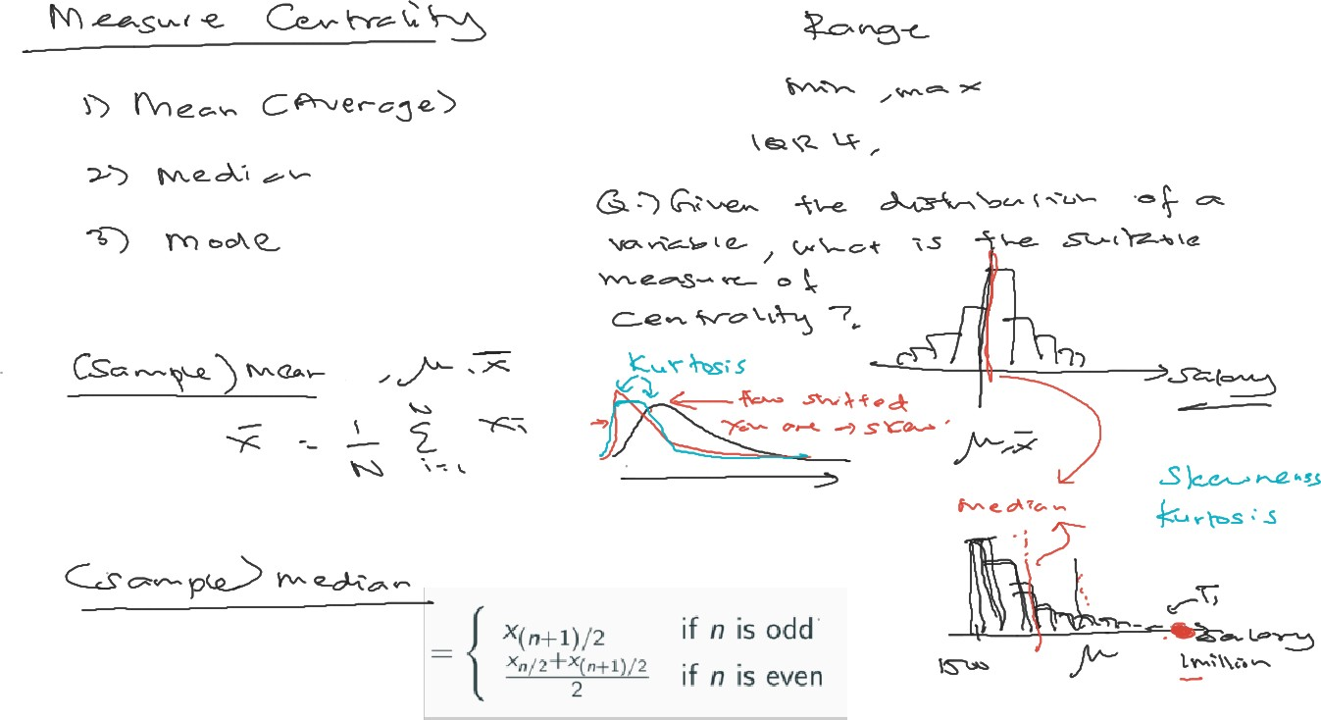


Slide 9
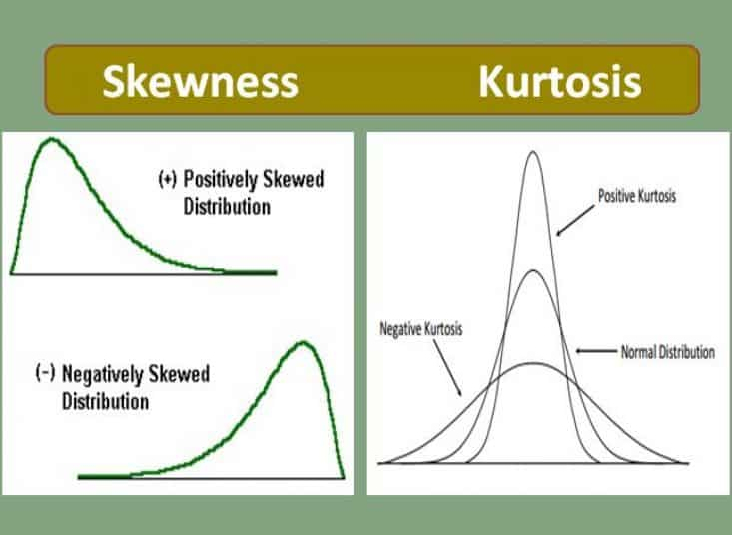

Slide 10
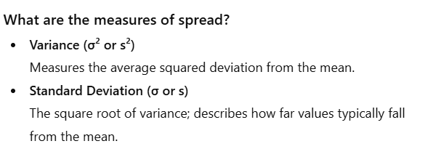
Measure of Spread

Slide 11
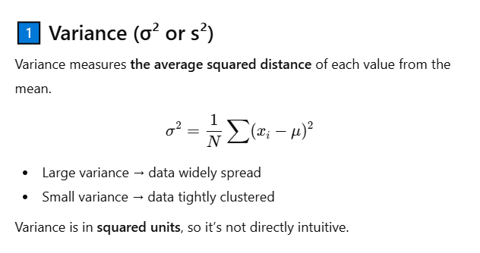
Measure of Spread

Slide 12
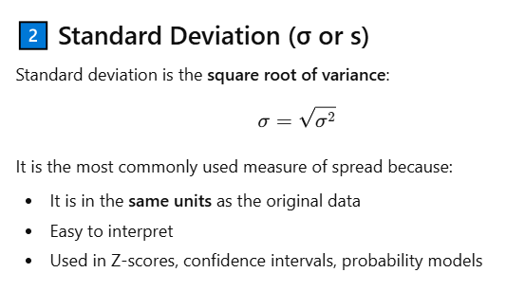
Measure of Spread

Slide 13









Why Spread Matters
1. Pattern Recognition
2. Statistical Inference
3. Anomaly / Outlier Detection

Slide 14
What does centrality and spread tells us?
What is the different between Population and Sample Data

Slide 15
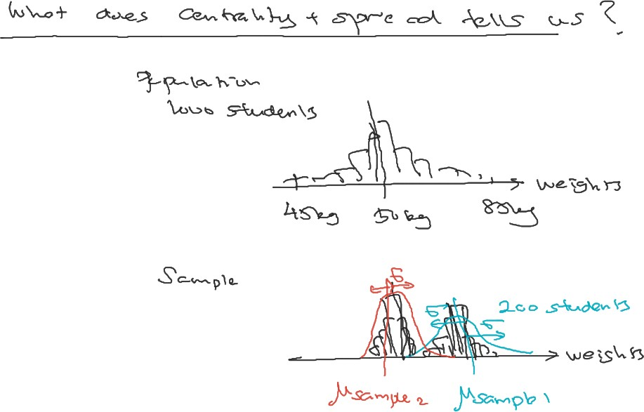

Slide 16
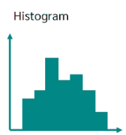
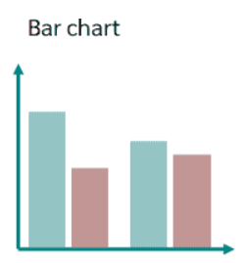
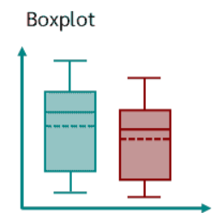
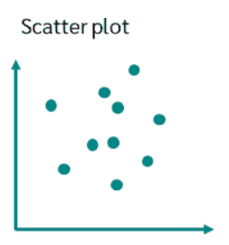
Visualization
What are the difference ways of visualization?
Histogram
Boxplot
Bar Chart
Scatter Plot
Visualization Tool | Type of Variable | Purpose
Histogram | Numerical (continuous) | View distribution & shape
Boxplot | Numerical (continuous) | View spread & outliers
Bar Chart | Categorical | Compare category counts
Scatter Plot | Numerical (2 variables) | Explore relationships

Slide 17
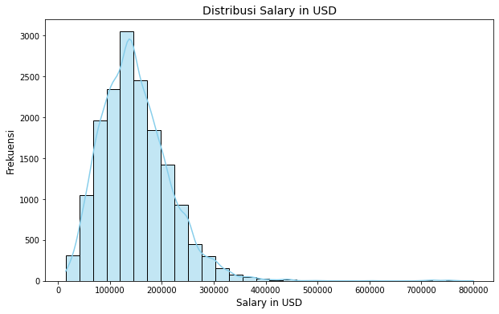

Slide 18
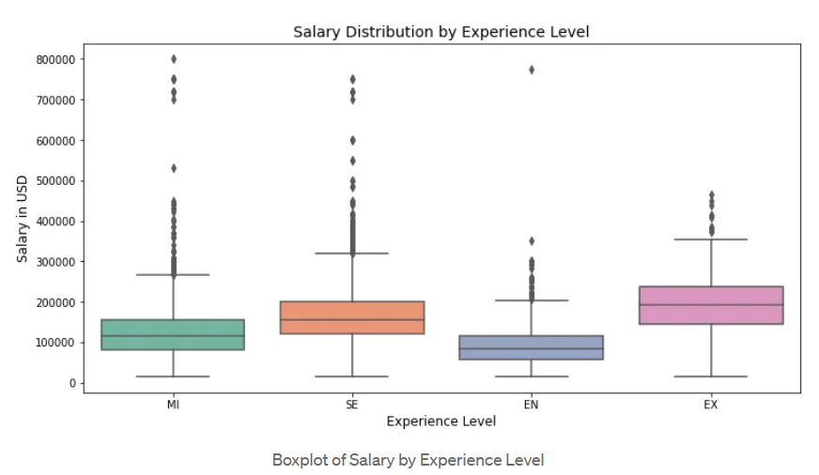

Slide 19
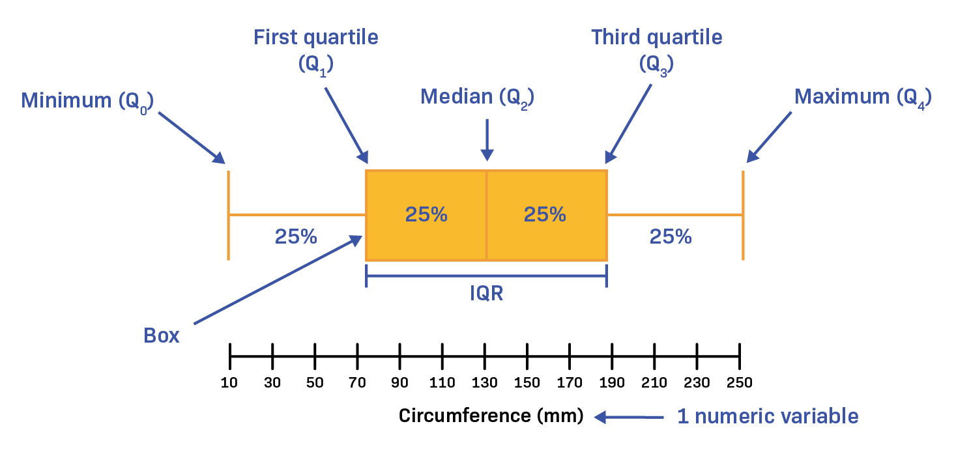

Slide 20
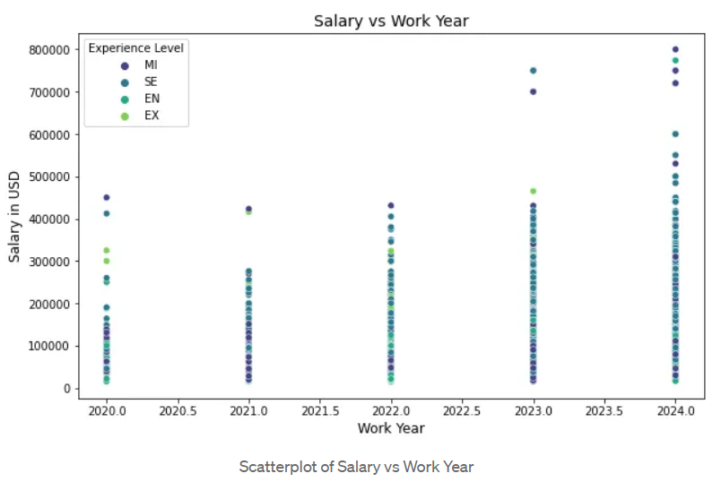

Slide 21
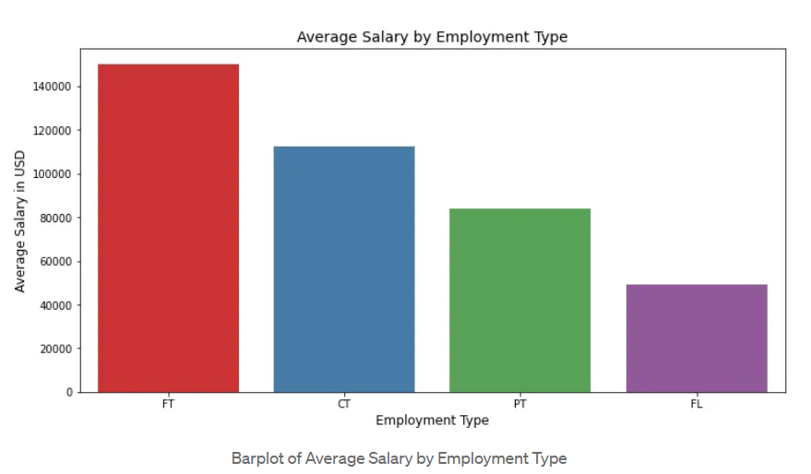

Slide 22
Descriptive Statistics/ Summary Statistics
Data can be presented in many different formats but, what are the main characteristics that describe the data set?
Descriptive statistics: summarize, organize, and present data concisely.
  They communicate something about the dataset without needing to understand the whole thing
  Summarize known data in a way that can be used for further predictions and analysis.
  Very useful for quickly understanding what’s going on
  Examples: Mean, median, mode

Slide 23
How not to use summary statistics
But, why not?
Do NOT take your dataset, compute the mean or median, and then call it a day.
If you do not understand your data ahead of computing the summary statistics, they can end up being useless, or actively misleading.

Slide 24
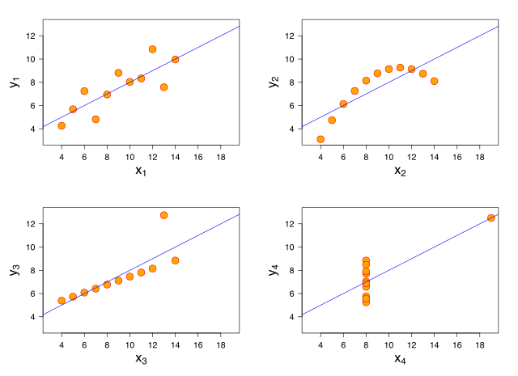
Why not to rely on summary statistics
All four of these have the same mean and variance, but are clearly generated by four different processes.

Slide 25
SUMMARY STATISTICS
Part of descriptive statistics, used to summarize data:
Convey lots of information with extreme simplicity
Descriptive statistics for a variable:
Measures of location: mean, median, mode
Measure of dispersion: variance, standard deviation

Slide 26
Types of Descriptive/ Summary Statistics
Measures of central tendency
Measures of Skewness
Measures of variability (spread)

Slide 27
Measures of Central Tendency

Slide 28
Measures of Central Tendency
Let y denote a quantitative variable, with observations y1 , y2 , y3 , … , yn
a. Describing the center
Median: Middle measurement of ordered sample.
The value in the dataset that has an equal number of items greater than and less than it.
Mean: Average of all observations in the dataset.
Mode: The most common item in your dataset

Slide 29
THE SAMPLE MEDIAN
Median:
Sort the data
Take the middle point*
Odd number:
Central observation: Med[1,2,4,6,8,9,17]
Even number:
Midpoint between the two central observations Med[1,2,4,6,8,9,14,17] = (6+8)/2=7
* CMSC351 will show you how to find the median in linear time!

Slide 30
MEASURES OF LOCATION
These are 30 hours of average defect data on sets of circuit boards. Roughly what is the typical value?
1.45 1.65 1.50 2.25 1.65 1.60 2.30 2.20 2.70 1.70
2.35 1.70 1.90 1.45 1.40 2.60 2.05 1.70 1.05 2.35
1.90 1.55 1.95 1.60 2.05 2.05 1.70 2.30 1.30 2.35
Location and central tendency
There exists a distribution of values
We are interested in the “center” of the distribution
Two measures are the sample mean and the sample median.
They look similar, and measure the same thing
They differ systematically (and predictably) when the data are not symmetric.

Slide 31
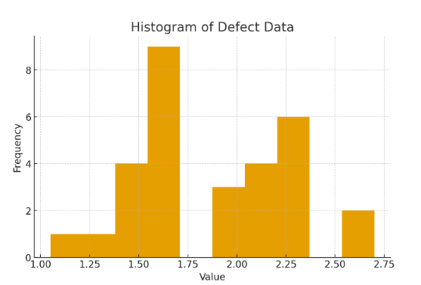

Slide 32
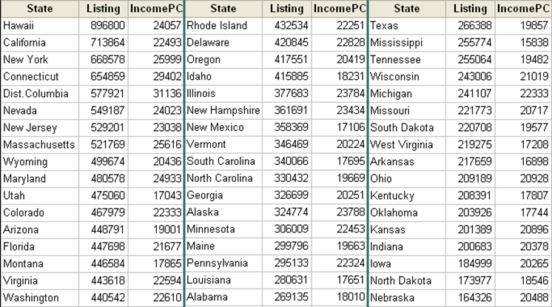
THE MEAN OF AGGREGATE DATA
Average list price:
1/51 ($898,800 + $713,864 + … + $164,326) = $369,687
32

Slide 33
AVERAGING AVERAGES?
Hawaii’s average listing = $896,800
Hawaii’s population = 1,275,194
Illinois’ average listing = $377,683
Illinois’ population = 12,763,371
Illinois and Hawaii each get an equal weight of 1/51 = .019607 when the mean is computed.
Looks like Hawaii is getting too much influence …

Slide 34
Measures of Central Tendency
Measures of Central Tendency tell you about the center of your distribution. It represents the whole set of data by a single value. These include:
The Pythagorean means
  Arithmetic Mean
  Geometric Mean
  Harmonis Mean
Median
Mode

Slide 35
Pythagorean Means

Slide 36
Pythagorean Means
Pythagorean means refer to three separate concepts: the arithmetic mean, the geometric mean, and the harmonic mean.
These means are named after the Pythagorean theorem because they are all forms of averaging.
Provide different ways of summarizing a set of numbers.

Slide 37
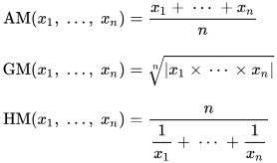
Pythagorean Means
Arithmetic Mean: Your typical average
  Sensitive to Outliers: Affected by extreme values.
    Equal Weight: Treats all values equally in calculation, regardless of its distance from the center of the dataset.

Slide 38
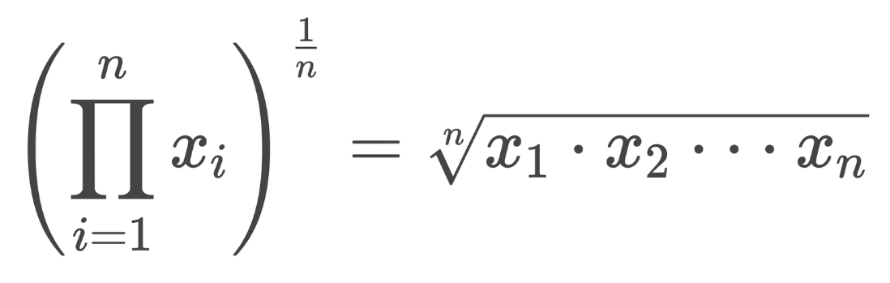
Pythagorean Means
Geometric Mean: Multiply all the values in a dataset and then take the nth root (n = number of values).
  Suitable for datasets with proportional values, such as growth rates or investment returns, as it accounts for relative changes rather than absolute values.
    Ideal for data that changes or grows over time, like COVID cases, investment returns, or population growth

Slide 39
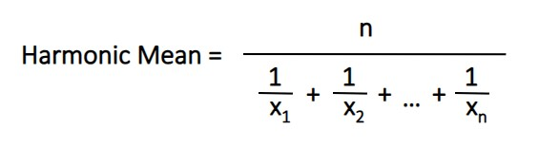
Pythagorean Means: (Harmonic Mean)
Harmonic Mean: is calculated by taking the reciprocal of the arithmetic mean of the reciprocals of all the values in a set.

Slide 40
2. Measures of Skewness: Other Descriptors

Slide 41
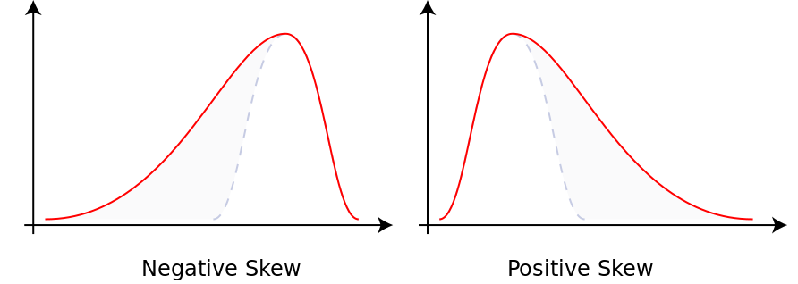
2. Measures of Skewness: Other Descriptors
Skewness is essential for understanding the shape and structure of the distribution of the data.
Skew (left or right tailed)
  Measures the asymmetry in data distribution.
  shows if the distribution is shifted to the left (negative skew) or right (positive skew).
Positive skew (right-tailed): the tail of the distribution extends to higher values
Typically Mean > median; more data points are on the left side of the distribution. Ex: Income distribution with a few high incomes.
Negative skew (left-tailed): Tail extends to lower values.
Typically Mean < median; more data points are on the right. Example: Test scores with a few extremely low scores.

Slide 42
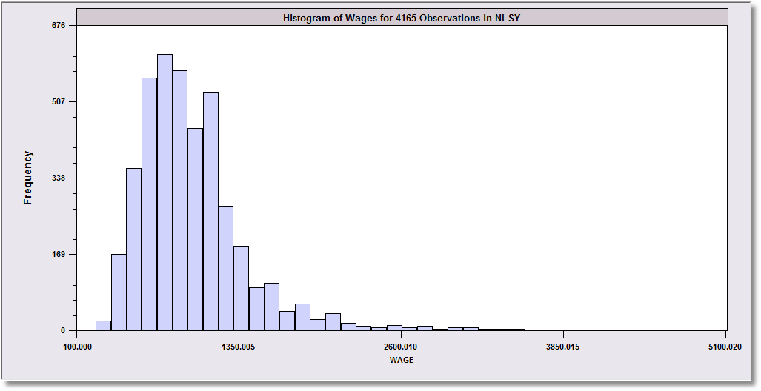
SKEWED DATA
Left-Skewed
Symmetric
Right-Skewed
Mean < Median
Mean = Median
Median < Mean
Monthly Earnings
N = 595,
Median = 800
Mean = 883
The mean will exceed the median when the distribution is skewed to the right.
Skewness is in the direction of the long tail
These data are skewed to the right.
Median
Mean

Slide 43




SKEWNESS
Extreme observations distort means but not medians.
Outlying observations distort the mean:
Med [1,2,4,6,8,9,17] = 6
Mean[1,2,4,6,8,9,17] = 6.714
Med [1,2,4,6,8,9,17000] = 6 (still)
Mean[1,2,4,6,8,9,17000] = 2432.8 (!)
Typically occurs when there are some outlying observations, such as in cross sections of income or wealth and/or when the sample is not very large.

Slide 44
3. Measures of Variance

Slide 45
3. Measures of Variance
An important characteristic of any set of data is the variation in the data; it reflects how tightly or widely data points are distributed around the mean.
The standard deviation and variance are the most common measures of this spread.
Good one: https://www.shiksha.com/online-courses/articles/variance-and-standard-deviation/

Slide 46
The standard deviation σ and The Variance
The Standard Deviation: provides a numerical measure of the overall amount of variation in a data set, and
Can be used to determine whether a particular data value is close to or far from the mean.
It's always positive or zero.
  When the data is clustered close to the average (mean), the standard deviation is small.
  When the data is spread out from the mean, the standard deviation is larger.
The Variance: the average of the squared differences from the Mean; indicates how far individuals in a group are spread out.
Standard deviation is the square root of the variance.

Slide 47
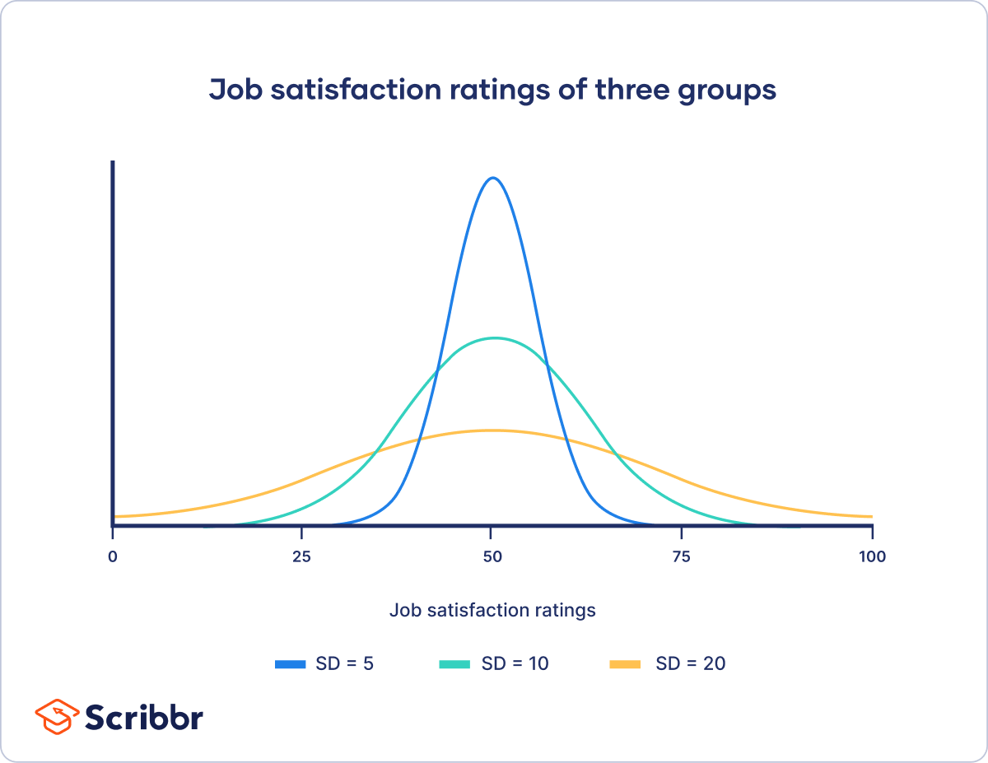
Interpreting Variability with Standard Deviation
Greater Variability (a wide, flat distribution curve): Larger standard deviation.
Less Variability (tall, spike-like distribution curve): Smaller standard deviation (data points are closer to the mean).
This visual representation helps us understand the level of variability in the data.

